Slide 1
EE2026 Digital Design
Chua Dingjuan elechuad@nus.edu.sg

Slide 2
Module Outline
Part 1
Number systems
Boolean Algebra and logic gates
Gate-level design and minimization
Combinational logic circuits and design
Logic IC family
Part 2
Sequential logic circuits
Flip-Flops, Counters, (Shift Registers)
Verilog review
Verilog behavioral and structural modeling
Digital finite state machine design
Modeling of FSMs using Verilog

Slide 3
Expected Learning Outcomes
– Able to design basic sequential logic circuits using flip-flops. – Able to design, build and test digital systems using FPGAs. – Able to design, model and simulate digital logic circuits using Verilog.
– Able to design and model simple state machines based on the FSM approach.

Slide 4
Module Organization
10-12 Lectures (2+1 hours / week)
5 Tutorial Sessions
Assessment
Weekly Quizzes – 5%
Luminus Quiz (MCQ, MRQ, FIB), three attempts.
Due Sunday of the following week. Eg. W6 quiz is due recess week Sunday.
Final Quiz – 15%
Week 13 (Venue & Time to be confirmed)

Slide 5
EE2026 Tutorial & Lab Schedule
Week | Tutorials | Lab | Quiz
WK 6 | --
Recess Week
WK7 | Tutorial – 6 | Project Lab 1
WK8 | Tutorial – 7 | Project Lab 2
WK9 | Tutorial – 8 | Project Lab 3
WK10 | Tutorial – 9 | Project Lab 4
WK11 | Tutorial – 10
WK12 |  | Project Lab 5 / Project Evaluation
WK13 |  |  | Final Quiz

Slide 6
SEQUENTIAL CIRCUITS - I
©Copyright CHUA DINGJUAN. All rights reserved.

Slide 7




Design a circuit to do this >>

When the button is pushed :
Turn On the light if it is Off
Turn Off the light if it is On
What is missing?
Remembering the previous state of the bulb ➔ MEMORY
Responding to an input EVENT (cf. input value)

Slide 8
Sequential Logic Circuits?
Combinational Logic Circuits:
Outputs depend on current inputs
Sequential Logic Circuits:
Outputs depend on current and previous inputs ➔ Memory!
Requires separation of previous, current, future : states
2 Types of sequential circuits:
Synchronous | Asynchronous
Clocked: need a clock input | Unclocked
Responds to inputs at discrete time instants governed by a clock input | Responds whenever input signals change

Slide 9
SR Flip-flop (FF)
The simplest memory element has two stable states : Flip-Flop (FF) ➔ it can store 1 bit of information
Most basic FF : Set-Reset (SR) Flip-flop / Latch
__Q
S
S | R | Output | Q+
0 | 0
0 | 1
1 | 0
1 | 1
0 0 is the rest state
Q
R
Implemented with NOR / NAND gates

Slide 10
SR Flip-flop (FF)

__
Q
S | R | Output Q
0 | 0
0 | 1 | Q = 0
1 | 0
1 | 1
S
Q
A | B | NOR
R
NOR Implementation

Slide 11

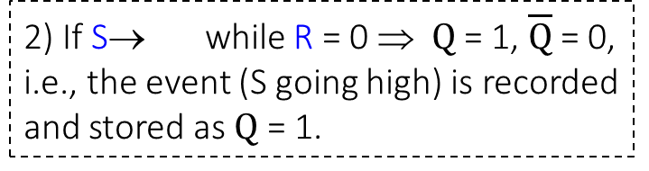
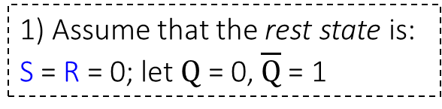
SR Flip-flop (FF)
FF can record and store transient events.
Switching is not instantaneous ➔ propagation delays
S
_ Q
S | R | Output
0 | 0 | Hold
0 | 1 | Q = 0
1 | 0 | Q = 1
1 | 1 | Invalid
0 0 is the rest state
R
Q
1) Assume that the rest state is: S = R = 0; let $Q$ = 0, $\overline{Q}$= 1
2) If S→ while R = 0 ⇒ $Q$ = 1, $\overline{Q}$ = 0, i.e., the event (S going high) is recorded and stored as $Q$ = 1.

Slide 12
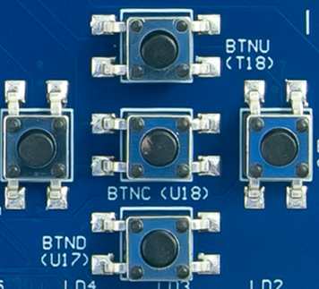
A Simple Application…
V_{CC}
close
open
(bounce)
(bounce)
(a) Output of typical mechanical switch
(b) Debounced switch output signal
S | R | Output
0 | 0 | Hold
0 | 1 | Q = 0
1 | 0 | Q = 1
1 | 1 | Invalid
0 0 is the rest state
Mechanical switches bounce before settling down which may cause problems as inputs.
Switch debouncing is a common use of S-R FFs.

Slide 13
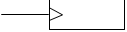
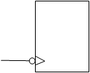
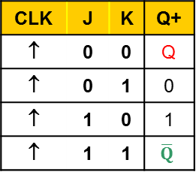
JK FF
The JK FF is based on SR with 2 improvements : _____ & ______
J
Q
CLK | J | K | Q+
↑ | 0 | 0 | Q
↑ | 0 | 1 | 0
↑ | 1 | 0 | 1
↑ | 1 | 1 | $$\overline{Q}$$
CLK | J | K | Q | Q⁺
↑ | 0 | 0 | 0 | 0
↑ | 0 | 0 | 1 | 1
↑ | 0 | 1 | 0 | 0
↑ | 0 | 1 | 1 | 0
↑ | 1 | 0 | 0 | 1
↑ | 1 | 0 | 1 | 1
↑ | 1 | 1 | 0 | 1
↑ | 1 | 1 | 1 | 0
Hold
Clear
Set
Toggle
K
_Q
condensed characteristic table
Clock input is a controlling input. It specifies when circuit read inputs / change outputs.
Synchronous circuits respond only at the _______ clock edges i.e., LOW → HIGH, HIGH → LOW transitions
At any other time, changing inputs have no effect on the output.
The JK FF is a synchronous circuit:
characteristic table
rising falling
edge edge

Slide 14


Respond @ Active Clock Edges
T_{i} T_{i+1} T_{i+2} T_{i+3} T_{i+4} T_{i+5}
CLK
1
J
0
1
K
0
1 hold clear hold set toggle
Q/Q⁺
0 t_{pHL} t_{pLH}
t_{setup}
?
When inputs don’t change ➔ FF outputs don’t change.
If inputs change ➔ FF output changes state only at active clock edge.

Slide 15
FF Timing Parameters
t_{setup} : minimum time before the active clock edge by which FF inputs must be stable.
t_{hold}: minimum time inputs must be stable after active clock edge
t_{pHL} : time taken for FF output to change state from High to Low.
t_{pLH} : time taken for FF output to change state from Low to High.
clock
t_{setup}
t_{hold}
What happens if inputs change state right at the active clock transition? Answer: output is _________________
Thus, input changes must meet required setup & hold times of device == Operating Speed of device
http://www.ti.com/product/SN74LS107A

Slide 16
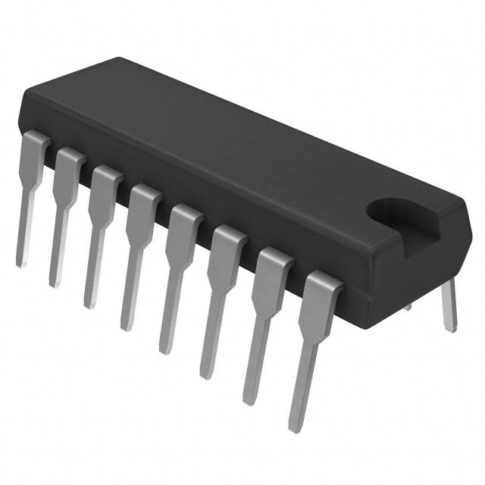
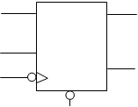

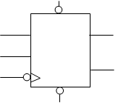

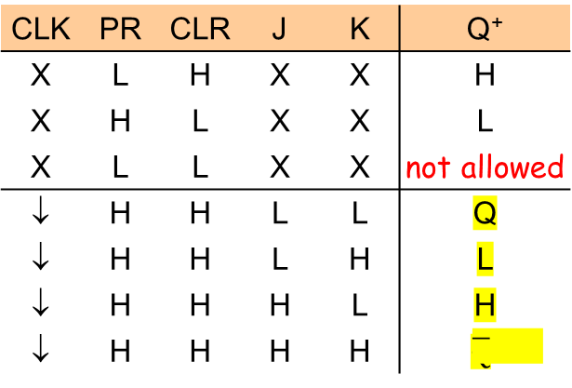
Commercially Available JK FFs
J Q
K _
Q
CLR
CLK | CLR | J | K | Q⁺
X | L | X | X | L
↓ | H | L | L | Q
↓ | H | L | H | L
↓ | H | H | L | H
↓ | H | H | H
74’107
74’107 with asynchronous clear
CLK | PR | CLR | J | K | Q⁺
X | L | H | X | X | H
X | H | L | X | X | L
X | L | L | X | X | not allowed
↓ | H | H | L | L | Q
↓ | H | H | L | H | L
↓ | H | H | H | L | H
↓ | H | H | H | H | $$\overline{Q}$$
PR
J Q
K _
Q
CLR
74’109
74’109 with direct set & direct clear

Slide 17
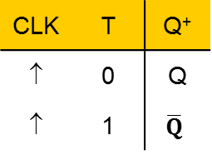
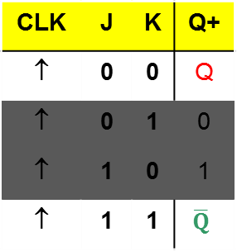
Other Flip-Flops…
D Q
_
Q
D Q
_
EN Q
CLK | D | Q⁺
↑ | 0 | 0
↑ | 1 | 1
EN | D | Q⁺
0 | X | No change
1 | 0 | 0
1 | 1 | 1
D Flip-Flop
D Latch
T Q
_
Q
J Q
K
_
Q
CLK | J | K | Q+
↑ | 0 | 0 | Q
↑ | 0 | 1 | 0
↑ | 1 | 0 | 1
↑ | 1 | 1 | $$\overline{Q}$$
CLK | T | Q⁺
↑ | 0 | Q
↑ | 1 | $$\overline{Q}$$
T
CLK
T Flip-Flop
A T Flip-flop made from a J-K Flip-flop
Since T Flip-flops are easy to construct from other FFs, they are not available commercially.

Slide 18
Verilog Time! – D-FF
D
Q
CLK | D | Q+
↑ | 0 | 0
↑ | 1 | 1
CLK
D
Q

Slide 19
Verilog Time! – D-FF
module dff ( input
output );
endmodule
D
Q
always @ (posedge clock)
begin
end
CLK | D | Q+
↑ | 0 | 0
↑ | 1 | 1
↑
always @ (posedge __)
always @ (negedge __)
↑

Slide 20
Some notes on: always & reg
Registers
Anything assigned in an always block must be type reg
In Verilog, the term register (reg) simply means a variable that can hold a value
Values of registers can be changed instantaneously. This is different from the wire type!
Always Block
Conceptually, the always block runs once when a signal in sensitivity list changes value.
Statements within always block are executed sequentially.
begin and end behave like parentheses/brackets
No assign!

Slide 21
Summary
SR Flip Flop & Applications
JK Flip Flop
FF Timing Parameters
Commercial JK Flip Flops
Verilog description of D Flip Flop

Slide 22
Practice Question
Given the circuit diagram below, complete the timing diagram below by filling in Q and Q. Assume that the initial value of Q is ‘0’ and include all propagation delays.
D
Q
CLK
Q
CLK
Q
Q

